Slide 1
ANALYSIS OF SOFR USING ADVANCED SQL TECHNIQUES
Under the Guidance OF
Prof. Jeff High
Group Members:
Amoolya Prakash
Rohit Khurana
Tharun Polamarasetty

Slide 2
OBJECTIVE
Detailed analysis of SOFR Vs. Other rates
Utilize SQL commands

Slide 3
PROJECT METHODOLOGY
Project Objective
Scope
Data Collection
Tools
Analysis & Results
Analysis of SOFR
SOFR, LIBOR,
Fed funds, AMERIBOR
Bloomberg
Excel
Statistical Analysis
New York Fed
Access – SQL Tools
St. Louis Fed

Slide 4
What is SOFR (Secured Overnight Financing Rate)
SOFR is based on transactions in the Treasury repurchase market, where banks and investors borrow or loan Treasuries overnight.
A group of large banks, the Alternative Reference Rate Committee (ARRC), selected the rate as an alternative to the London interbank offered rate (Libor) in derivatives.
Depth and robustness of the market where around $800 billion is traded daily.

Slide 5
OTHER RATES
AMERIBOR
An index of overnight unsecured lending taking place across the CBOE platform AFX. It is mainly concerned with the interbank market between smaller, regional US banks.
Fed Funds Rate
Interest rate that banks charge other banks for lending them money from their reserve balances on an overnight basis.
LIBOR
A benchmark interest rate at which major global banks lend to one another in the international interbank market for short-term loans.

Slide 6
RATES OVER TIME

Slide 7
SOFR – Most Volatile
SQL QUERY
SELECT DISTINCTROW AVG([SOFR].[SOFR]) AS [AVG OF SOFR], ROUND(STDEV([SOFR].[SOFR]),4) AS [DEV OF SOFR],MIN([SOFR].[SOFR]) AS [MIN OF SOFR], MAX([SOFR].[SOFR]) AS [MAX OF SOFR], COUNT(*) AS [COUNT OF SOFR]
FROM SOFR;
SQL RESULT
SUMMARY
AVG OF SOFR | DEV OF SOFR | MIN OF SOFR | MAX OF SOFR | COUNT OF SOFR
2.1818 | 0.3156 | 1.6500 | 5.2500 | 371

Slide 8
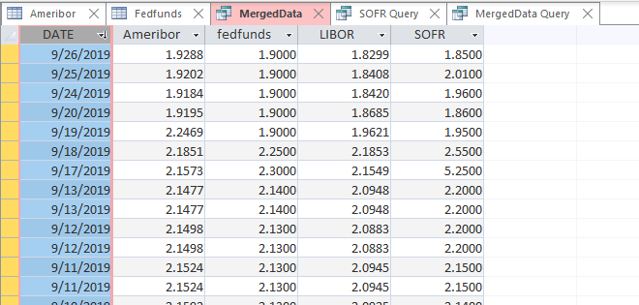
MERGE DATA
SQL RESULT
SQL QUERY
SELECT
a.DATE, a.Ameribor, f.fedfunds, l.LIBOR, s.SOFR
FROM Ameribor AS a, fedfunds AS f, LIBOR AS l, SOFR AS s
WHERE
a.DATE = l.DATE AND
a.DATE=s.DATE AND
a.DATE = f.DATE
AND
a.Ameribor IS NOT NULL AND
f.fedfunds IS NOT NULL AND
l.LIBOR IS NOT NULL AND
s.SOFR IS NOT NULL;

Slide 9
EXPLORATORY ANALYSIS
6
Number of Instances where
|SOFR - FEDFUNDS| >= 30 bps
SQL Query
SELECT COUNT(*)
FROM MergedData
WHERE ABS(SOFR-fedfunds) >=0.30

Slide 10
EXPLORATORY ANALYSIS
1
Number of Instances where |AMERIBOR - FEDFUNDS| >= 30 bps
SQL Query
SELECT COUNT(*)
FROM MergedData
WHERE ABS(AMERIBOR - fedfunds) >=0.30

Slide 11
EXPLORATORY ANALYSIS
6
Number of Instances where |SOFR – LIBOR| >= 30 bps
SQL Query
SELECT COUNT(*)
FROM MergedData
WHERE ABS(LIBOR-SOFR) >=0.30

Slide 12
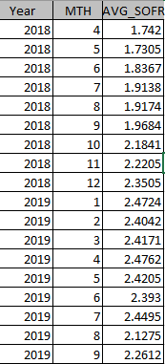
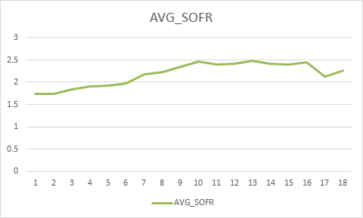
USE OF GROUP BY CLAUSE
RESULT
SQL QUERY
SELECT YEAR(DATE) AS Year, MONTH(DATE) AS MTH, ROUND(AVG(SOFR),4) AS AVG_SOFR
FROM MergedData
GROUP BY MONTH(DATE), YEAR (DATE)
ORDER BY YEAR(DATE);

Slide 13
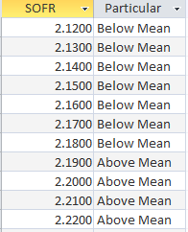
USE OF CASE/ SWITCH STATEMENT
RESULT
SQL QUERY
SELECT SOFR,
SWITCH(SOFR >2.1818, "Above Mean",
SOFR<2.1818, "Below Mean")
AS Particular
FROM MergedData
GROUP BY SOFR;

Slide 14
NEAREST NEIGHBOUR
RESULT
SQL QUERY
LIBOR appears to be closest to Fed Funds rate
AMERIBOR appears to be farthest from Fed Funds rate
SELECT ABS(ROUND(AVG(SOFR-Fedfunds),4)) AS SOFR_Fedfunds,
ABS(ROUND(AVG(LIBOR-Fedfunds),4)) AS LIBOR_Fedfunds,
ABS(ROUND(AVG(AMERIBOR-Fedfunds),4)) AS AMERIBOR_Fedfunds
FROM MergedData;

Slide 15
REFERENCES
https://www.clarusft.com › ameribor
https://www.investopedia.com/terms/f/federalfundsrate.asp
https://www.investopedia.com/terms/l/libor.asp

Slide 16
THANK YOU

